Slide 1


Dataverse - Fabric Real Time Intelligence
+
Rich Business Data for AI transformation
Scott Sewell | Microsoft
Fabric CAT, Principal Program Manager
Arindam Chatterjee | Microsoft Principal Product Manager, Fabric Real-time Intelligence

Slide 2
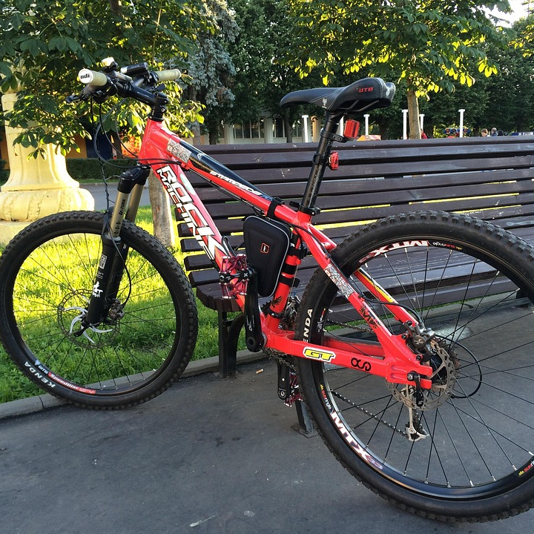
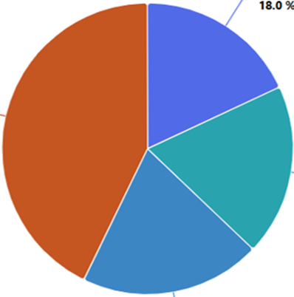

Agenda
Overview of Real-Time Intelligence for Fabric
Inbound RTI Events to Dynamics
Outbound RTI Events from Dynamics

Slide 3



Title
Collect
Analyze
Derive Insights
Act
Notes:
We all know that data is the fuel for AI. What started with just a few large organizations collecting & analyzing user clicks and online activities, … today has grown to include almost every forward-looking competitive businesses collecting, analyzing, extracting insights and driving intelligent actions – all in real-time.

Slide 4



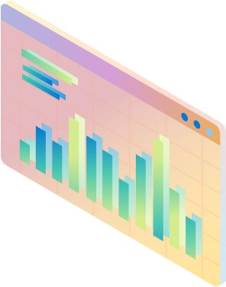








Title
Collect
Analyze
Derive Insights
Act
Accelerated by AI
Notes:
… and this cycle has only been accelerated by the recent use of AI. AI models, large or small, foundational or domain specific, feed on copious amounts of data, help generate even more content that feed right back into this cycle. This cycle can only be sustained through real-time intelligence. AI solutions are dependent on high quality data for accurate output.
Businesses that embrace real-time intelligence cycle gain a competitive edge—they make faster, smarter, and more precise decisions at the moment they matter most.

Slide 5
Title
Automotive
Manufacturing
Logistics
Finance & Insurance
Energy & Utilities
Retail
Connected fleet applications
Autonomous Driving
Manufacturing + R&D
Improving Quality and Throughput
Predictive Maintenance
Inventory Prediction
Delivery tracking and routing
Warehouse management
Supply & demand operations
Finance Automation
Fraud Detection
Operational Efficiency
Station monitoring, energy leakage detection
Equipment Maintenance & Monitoring
Failure Monitoring
Inventory tracking
Promotions and buying experiences
Supply chain management
Notes:
We are seeing this gain traction as more and more industries recognize that real-time insights make all the difference.
And this is not just a tech industry problem—it affects every sector, from operations to customer experience:
Manufacturing – Enhancing quality and throughput, enabling predictive maintenance, and optimizing inventory to prevent shortages and overstocking.
Finance – Driving automation, strengthening fraud detection, and improving operational efficiency in trading, banking, and risk management.
Retail & Online Advertising – Maximizing real-time ad targeting, optimizing conversions, and adjusting pricing dynamically.
And through all these steps, maintaining data quality, detecting and handling any deviations is paramount. It is not just data that fuels AI – it is high-quality, real-time data that fuels AI.

Slide 6





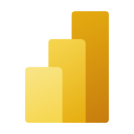



Microsoft Fabric
The unified data platform for AI transformation
Data
Factory
Analytics
Databases
Real-Time Intelligence
Power BI
Fabric Platform
AI
OneLake
Purview

Slide 7



Real-Time Intelligence in Microsoft Fabric
Ingestion
Analytics
Digital Twin Builder
Dashboards
Rules
Actions
Real-Time Hub
AI
Notes:
With Real-Time Intelligence Microsoft Fabric now truly supports the world of streaming and event data, all within the single data platform for era AI

Slide 8














Dataverse with Fabric Real-time Intelligence
+
AI Agents
Real-time Dashboards
Spark Incremental Processing
Event-driven applications
Integration
Low Latency
Event driven Analytics & Anomaly Detection
Change Events
Efficient Incremental Processing
Real-time Insights & Decision Making
Notes:
With Fabric Real-time Intelligence, an important capability becomes more feasible. In addition to the source Dataverse table data being mirrored into Fabric, fine-grained change events from Dataverse are also made available in Fabric at a low-latency (within seconds) through Fabric Eventstreams. This opens up a number of different use cases, including event-driven analytics and anomaly detection, efficient incremental processing using Spark or KQL to process only the changed data rather than the entire table, and AI-powered real-time insights and decision-making. For example, in a retail environment, when a product's stock level changes due to a sale or restocking, only the changed data is streamed over to Fabric, enabling real-time insights based on Spark Structured Stream processing and actions such as automatically triggering reorders or updating online store availability almost instantly. The benefits include lower latency, improved responsiveness, and the ability to act on fresh data in real-time.
Rewrite:
With Fabric Real-time Intelligence, a new capability becomes much more feasible. Not only is the source Dataverse table data mirrored into Fabric, but fine-grained change events from Dataverse will also be available in Fabric with very low latency, within seconds, through Fabric Eventstreams. This opens up various use cases, like event-driven analytics, anomaly detection, and efficient incremental processing using Spark or KQL to process only the changed data instead of the entire table. It also enables AI-powered real-time insights and decision-making.
For example, in a retail environment, when a product's stock level changes due to a sale or restocking, only the changed data is streamed over to Fabric. This allows for real-time insights based on Spark Structured Stream processing and actions like automatically triggering reorders or updating online store availability almost instantly. The benefits include lower latency, improved responsiveness, and the ability to act on fresh data in real-time.

Slide 9
Real-Time Intelligence for Dataverse
+
“Real-Time” Faster Faster Faster
Two Use Cases for Real-Time Data with Dataverse
Inbound data from external sources
Outbound data from Dataverse

Slide 10
Inbound Sources
+
The world moves forward in “Real-Time”
🏭 IoT Devices
🖥️ Applications
🤖 AI Agents

Slide 11





Real-Time into Dataverse
+
Real-Time Data Driving Power Platform
Power Platform
🏭
🖥️
🤖
Fabric
Activator
Power Automate
Dataverse
Eventstream
Power BI Report
Eventhouse

Slide 12
Demo
Data inbound from London Bicycle Racks
Conditionally trigger on low bike status
Create case action in Dataverse / Dynamics 365

Slide 13


Listen to Dataverse Events
+
Fastest way to visualize Dataverse Data
Dataverse
Fabric Real-Time Hub
Activator
KQL
KQL
Power BI Report
Plugin Registration Tool
Eventstream
Eventhouse
Real-Time Dashboard

Slide 14
Demo
Data Outbound from Dataverse Events
Capture with Eventstream
Aggregate in Eventhouse
Visualize with RTI Dashboard and Power BI

Slide 15
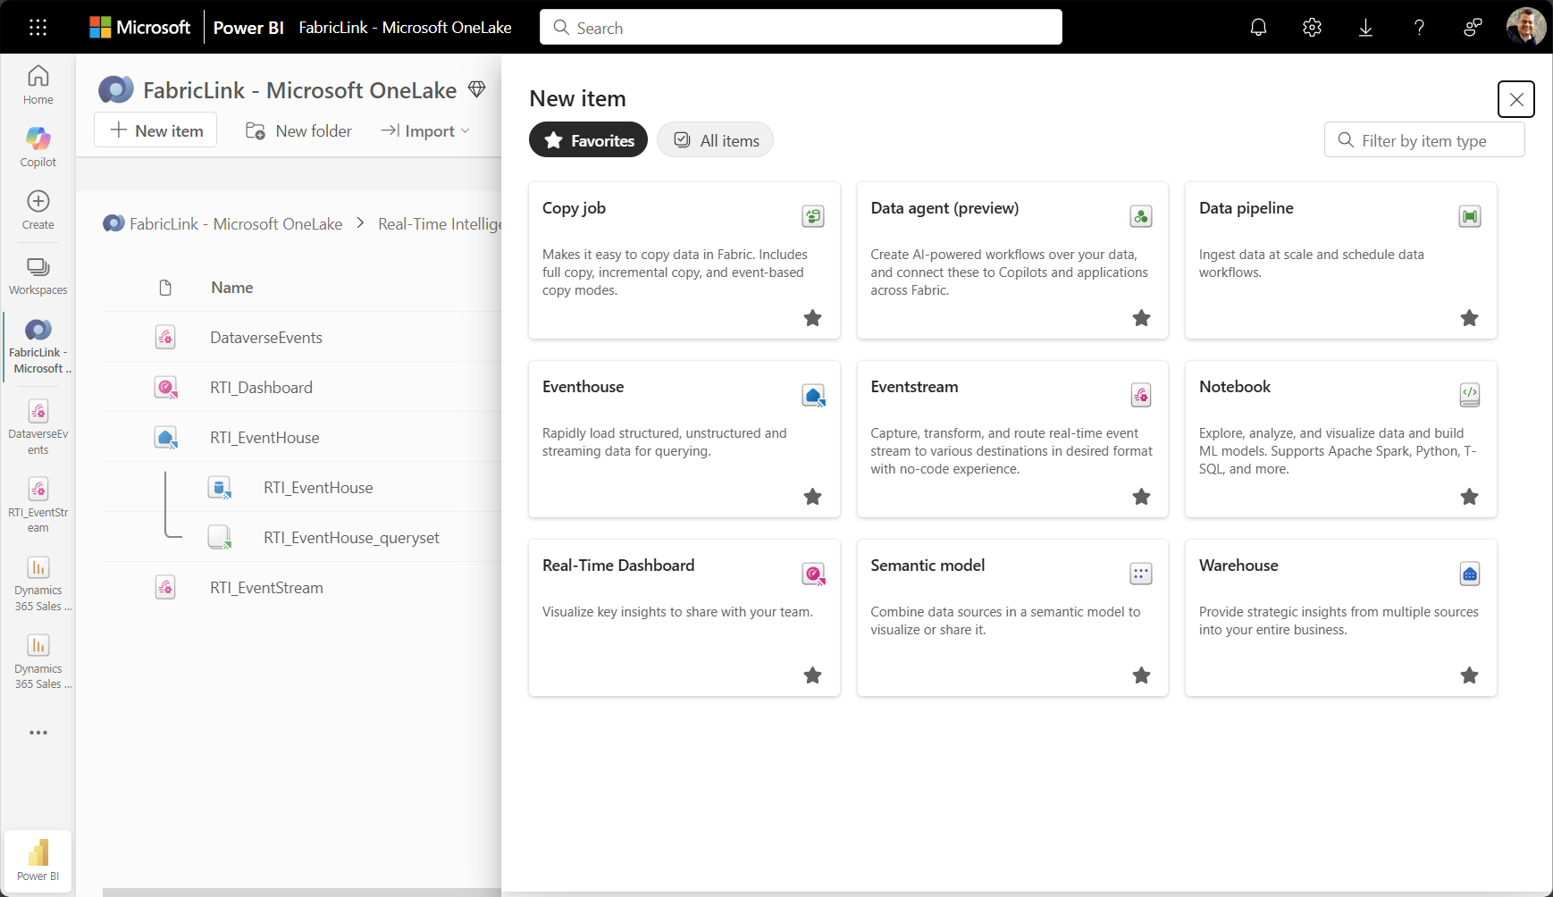
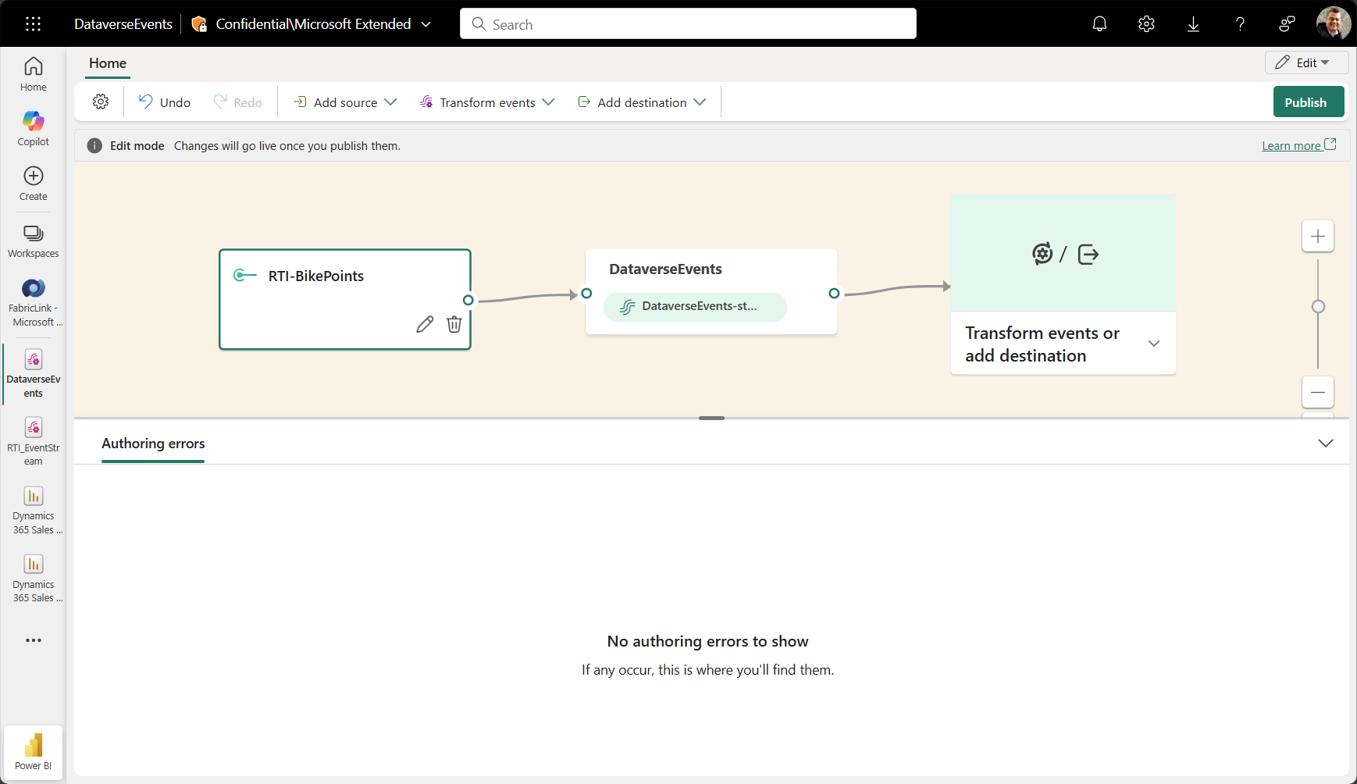
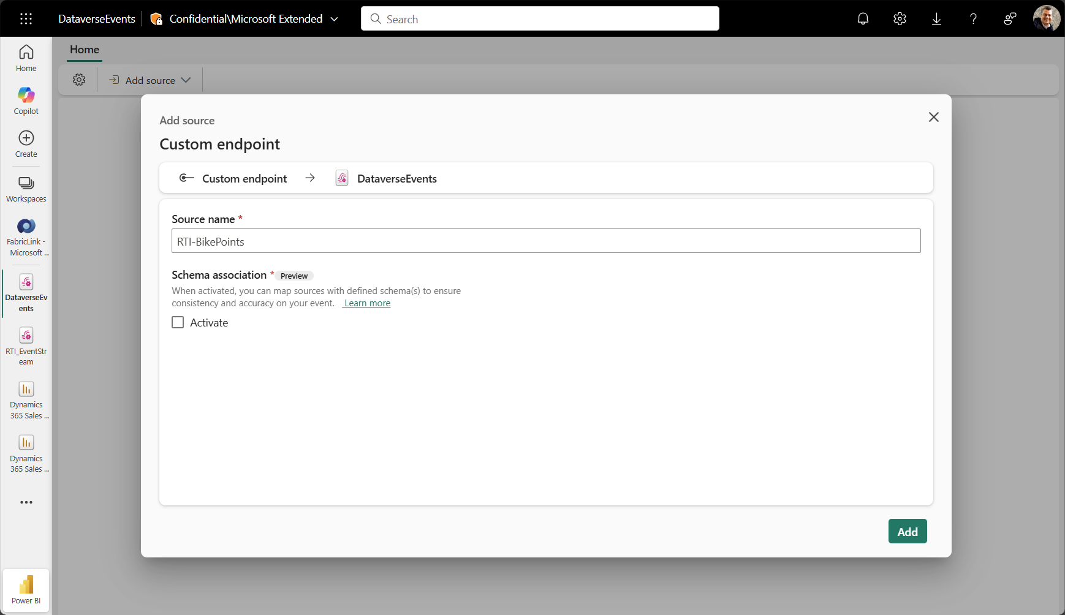
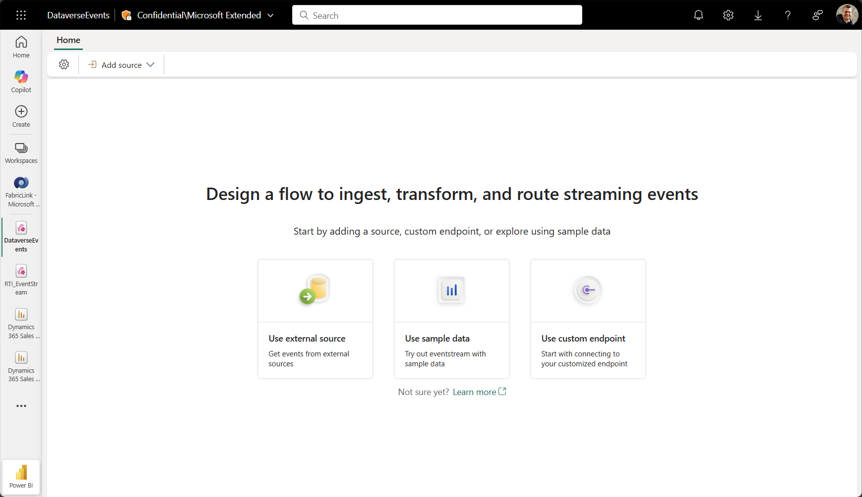
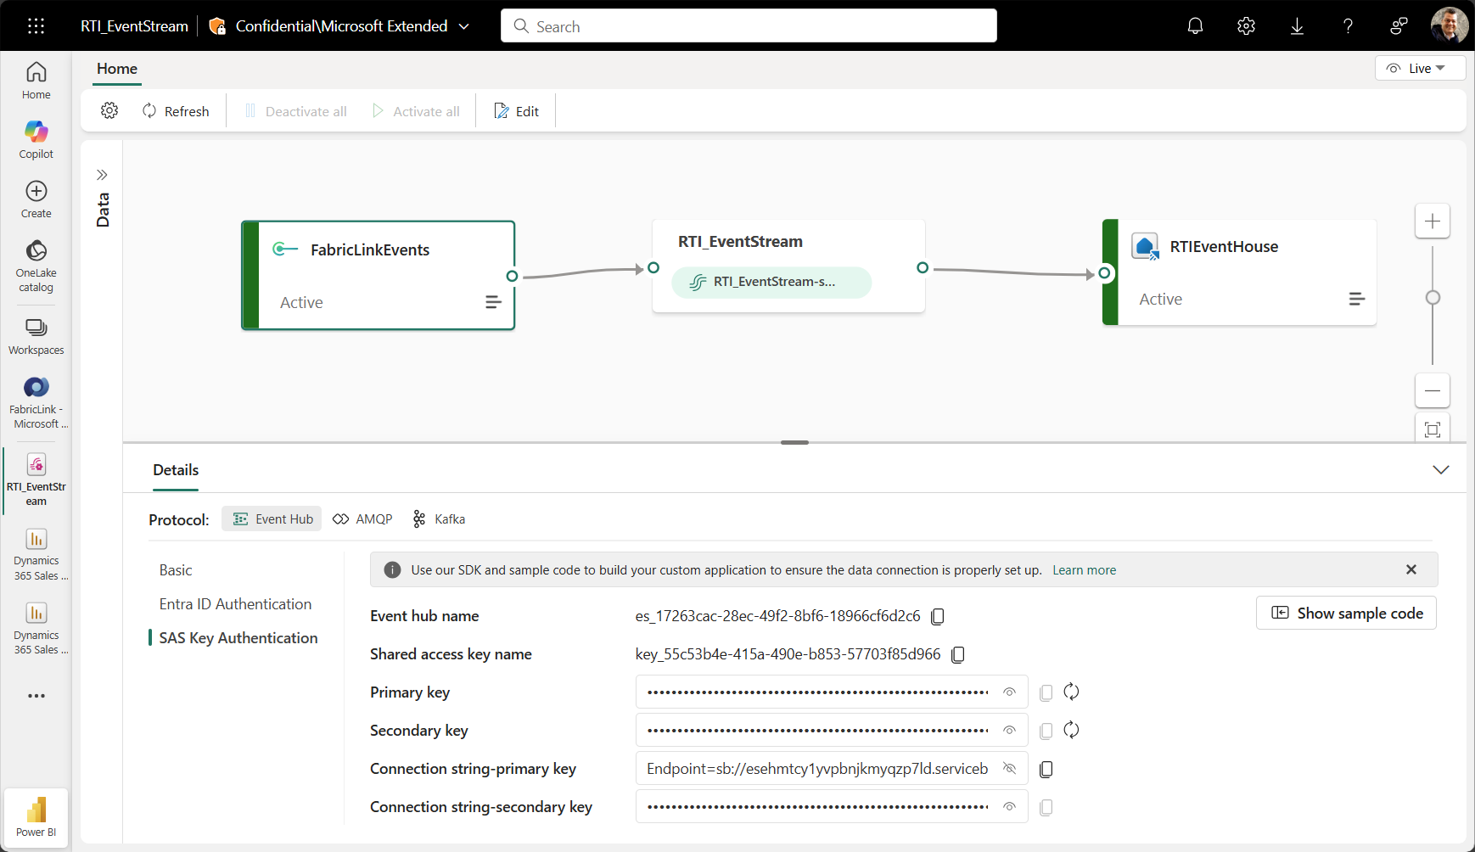
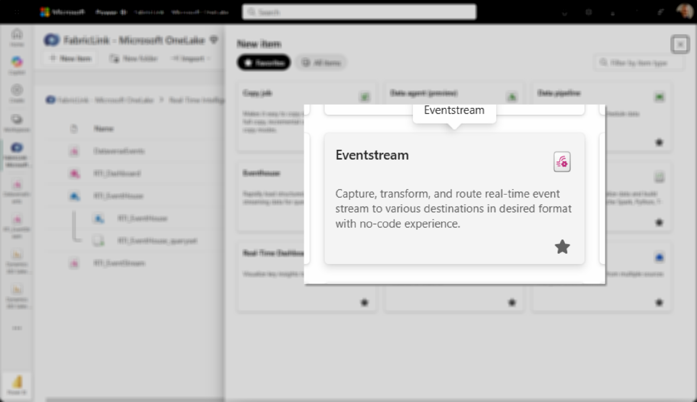
Configure a Fabric Eventstream
Custom endpoint
Name It
Publish!
Copy the Connection String

Slide 16
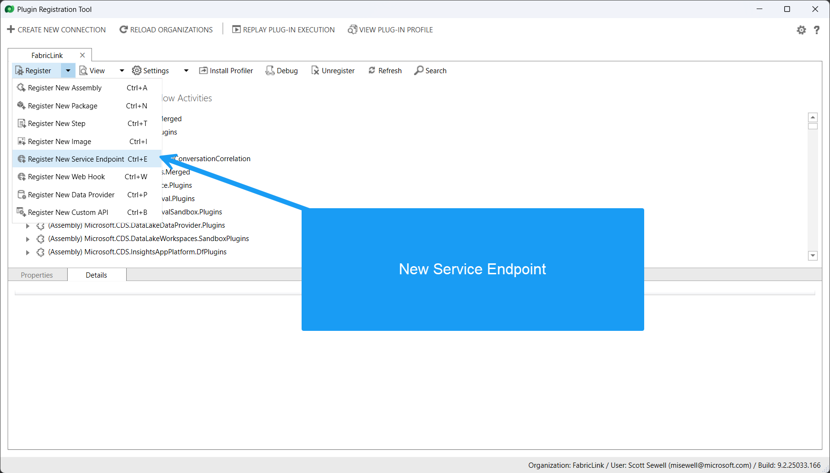
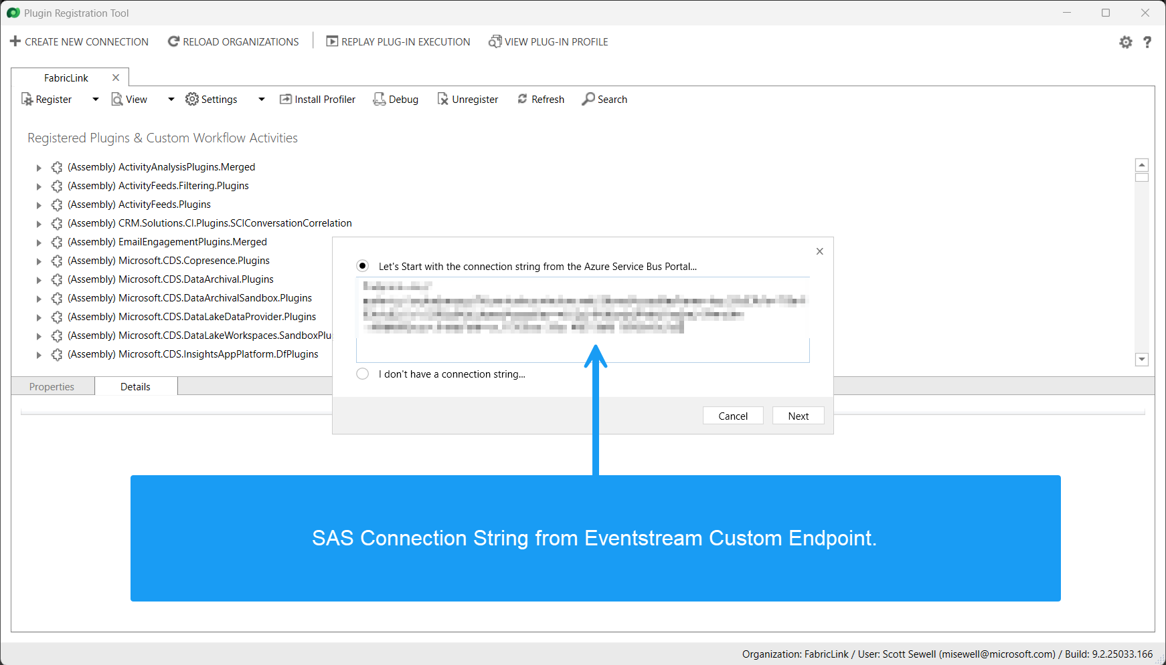
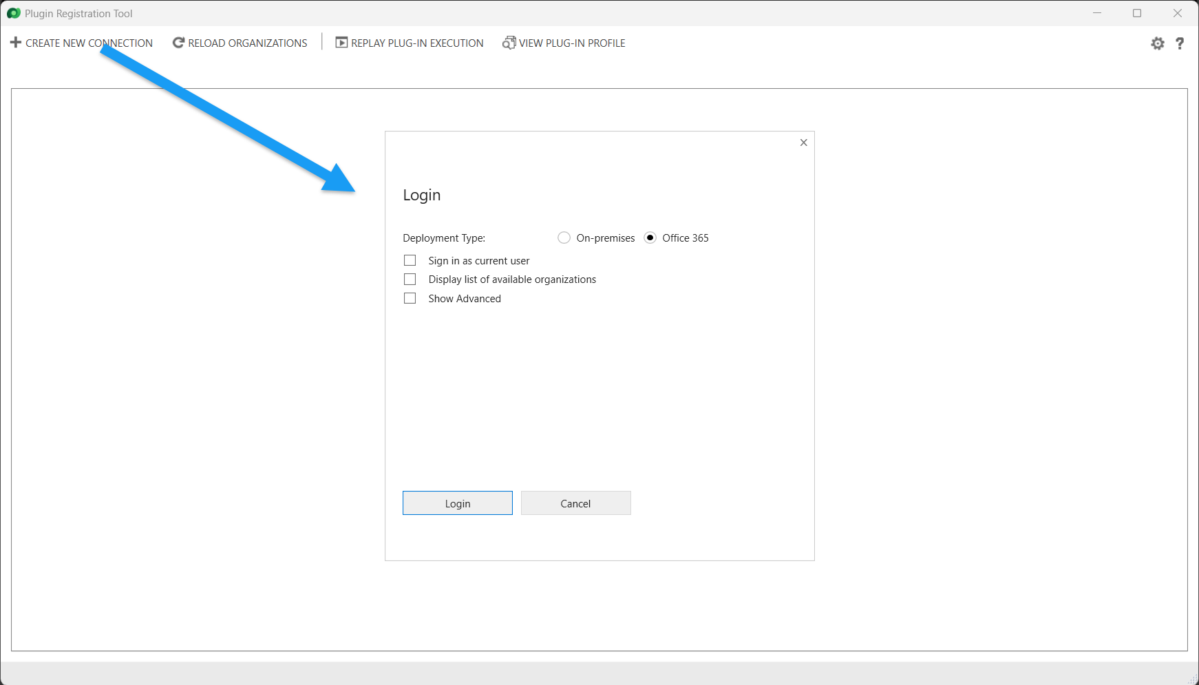
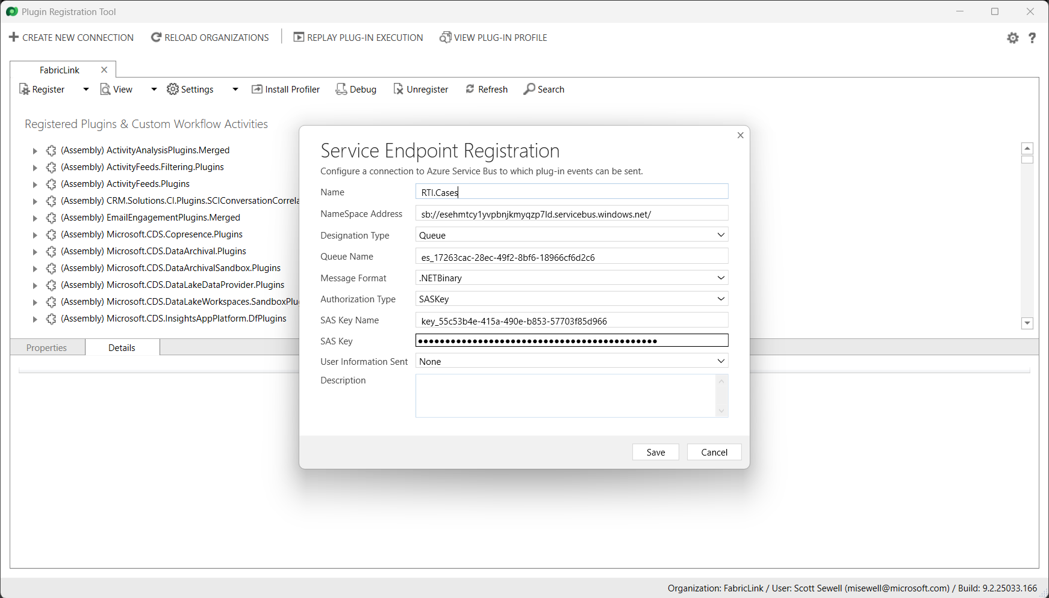
Dataverse Plugin Registration Tool : Service Endpoint

Slide 17
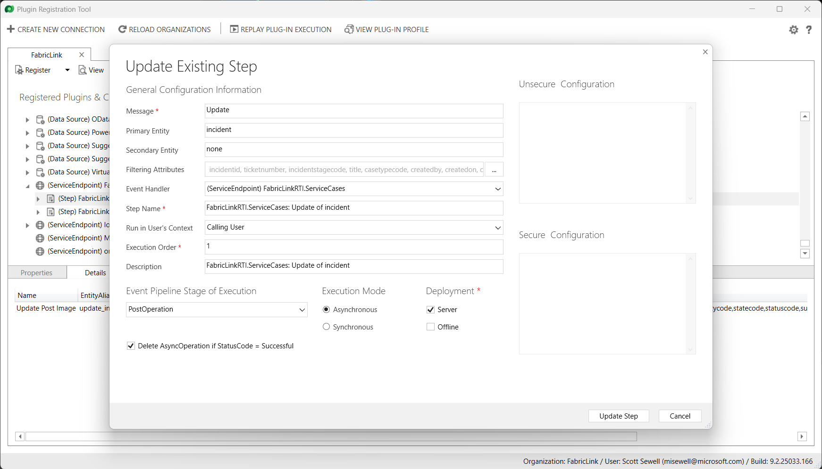
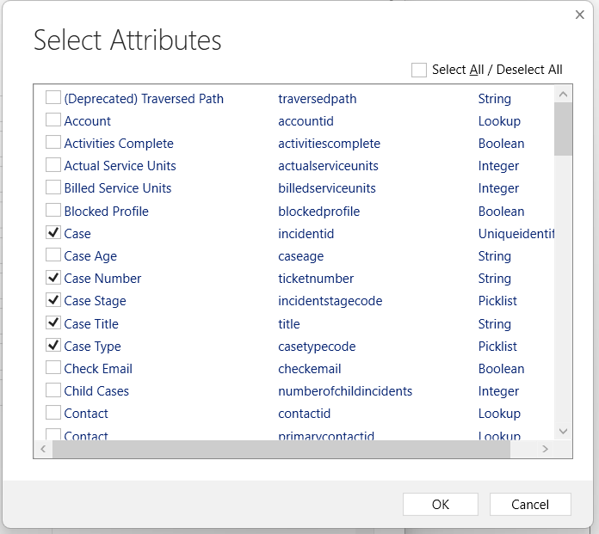
Configure a Step and Post Image

Slide 18
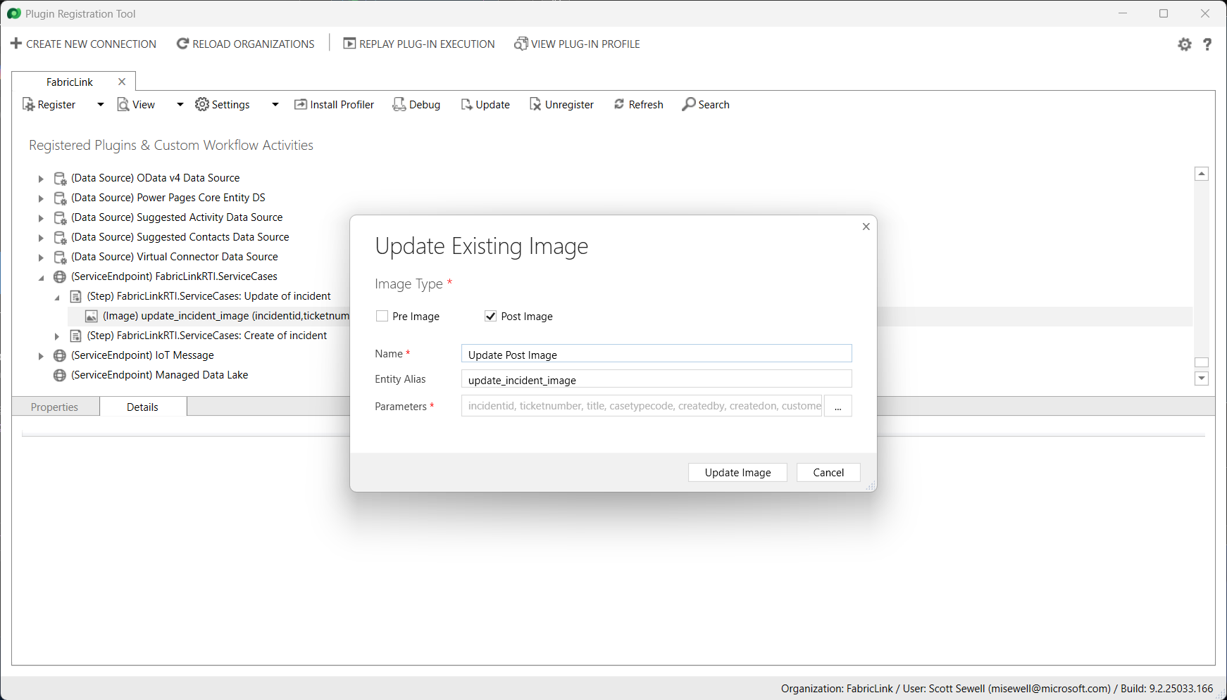
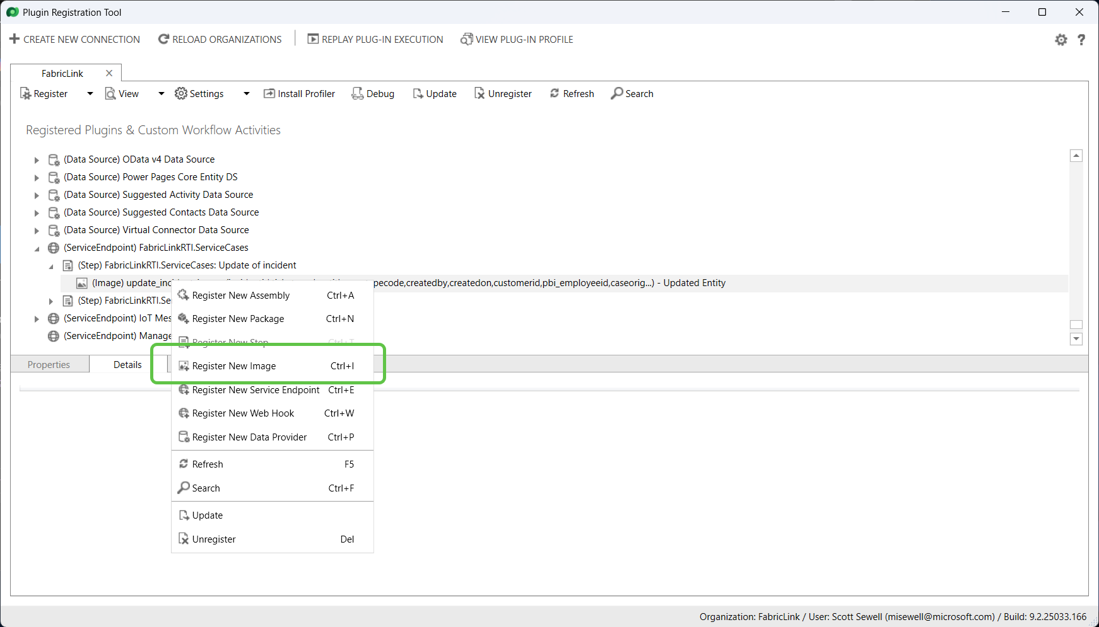
Add a Post Image

Slide 19
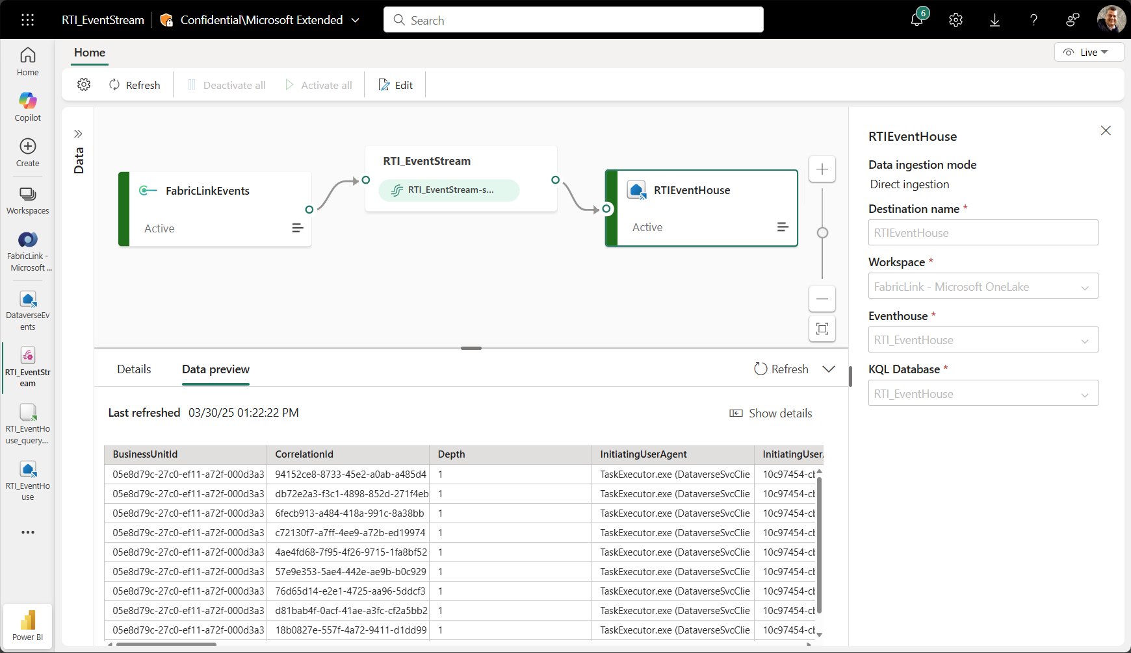
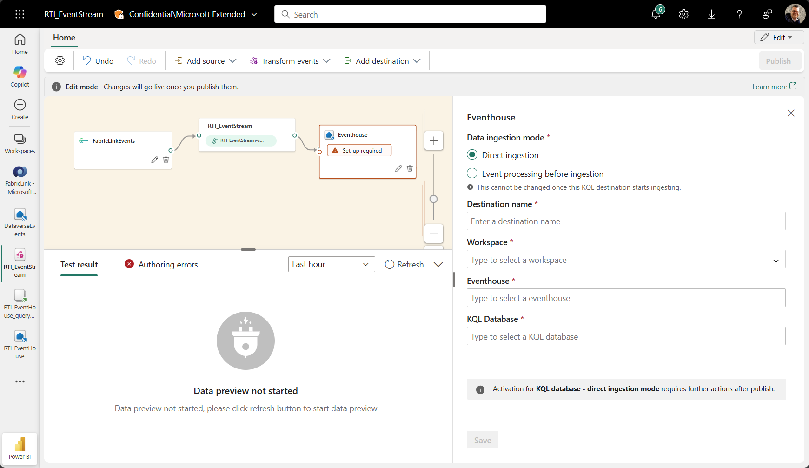
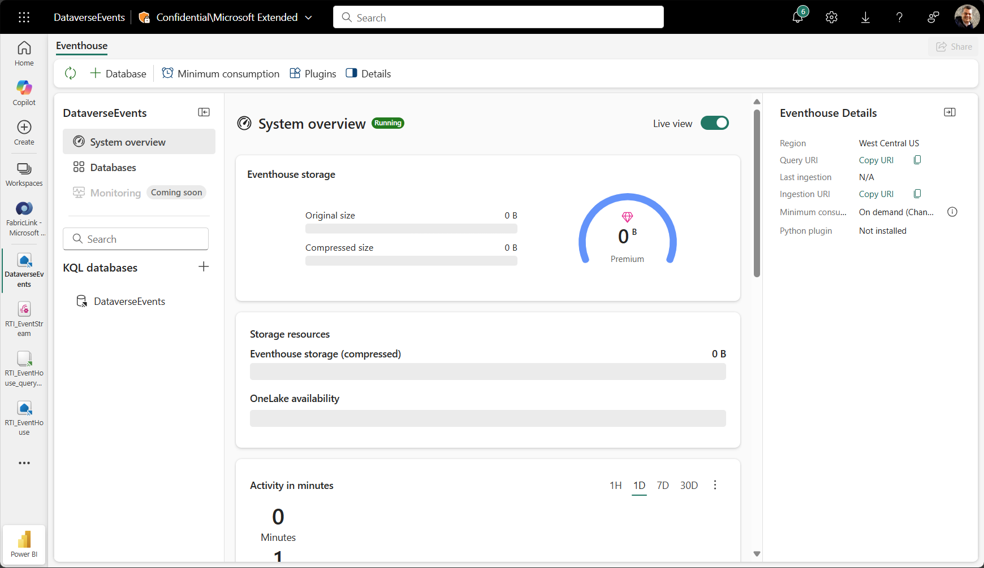
Create an Eventhouse and link to Eventstream
Connect to Eventhouse
Create db “Incidents_Raw”
Publish.

Slide 20
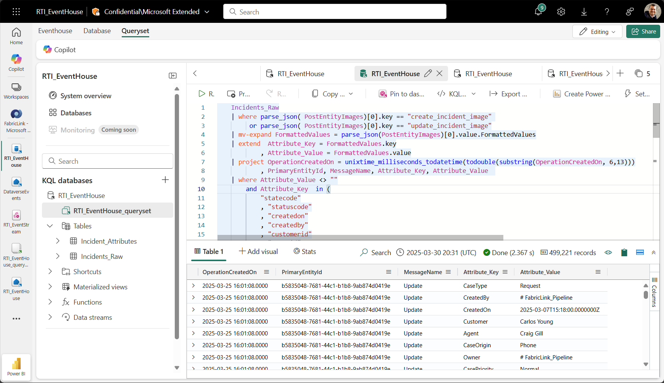
Use KQL to query the events from the Eventhouse

Slide 21
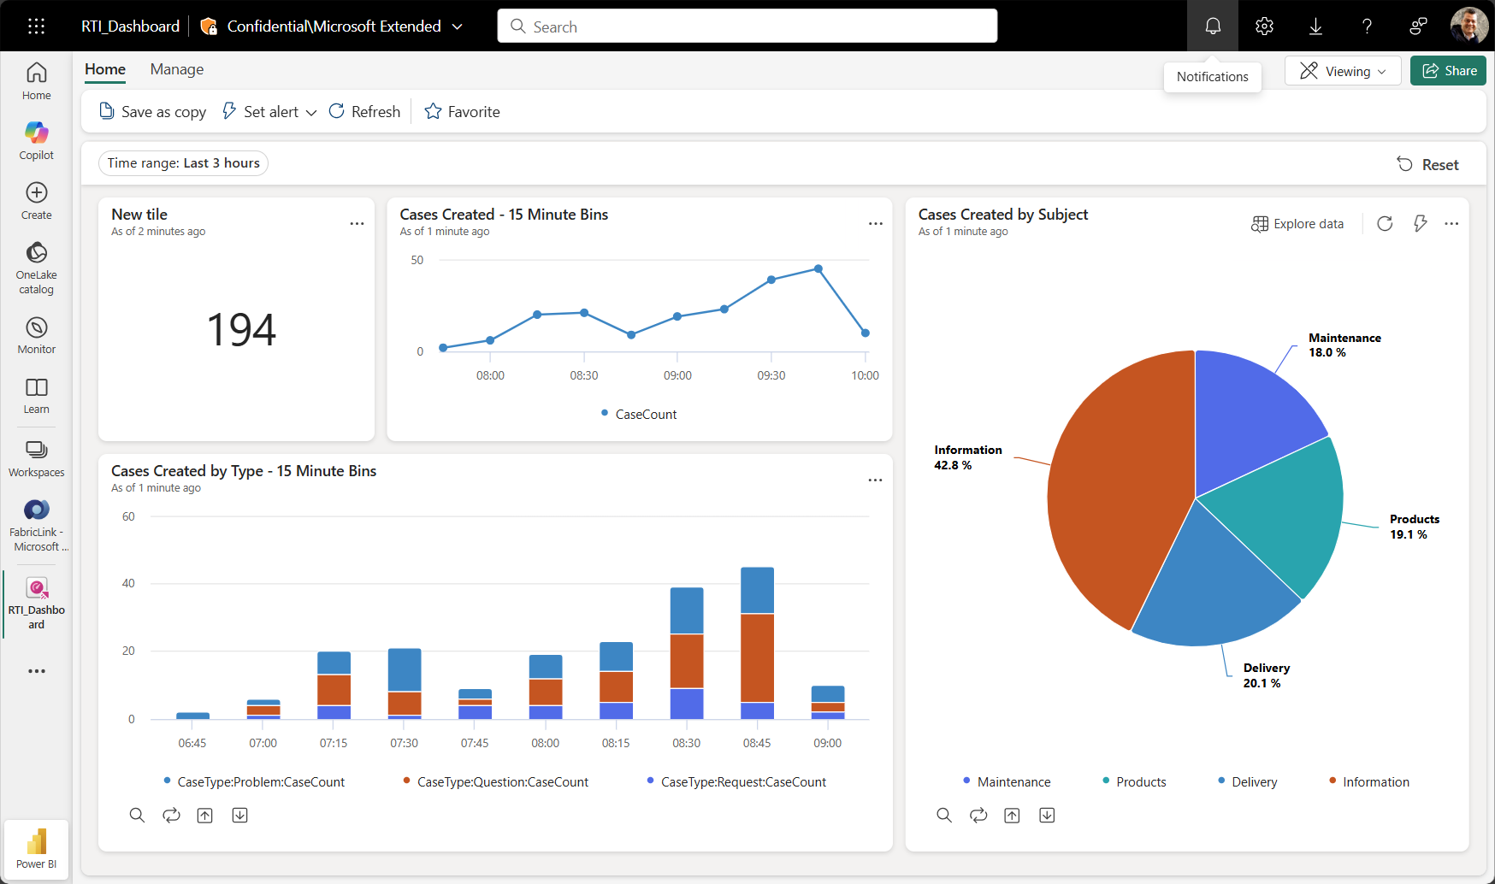
Visualize using a Real-Time Dashboard

